Slide 1

BIXBAR: A Low Cost Solution to Support Dynamic Link Reconfiguration in Networks on Chip
Pablo Abad, Pablo Prieto, Valentin Puente, Jose-Angel Gregorio
University of Cantabria

Slide 2
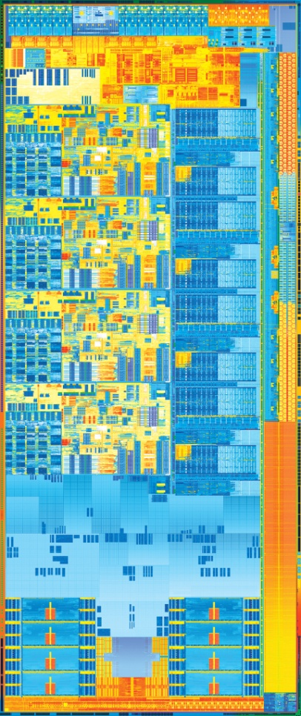
CMP environment
Direct Interconnects have become a standard for CMP communication substrate.
Ring -> Mesh in a near future.
Higher bandwidth requirements.
Env. Requirements:
- Area and Energy first-order design constraints.
BW availability-> short messages.
High operation frequency.
Low latency communications required.
Dimension Order Routing (DOR).
Fast and simple logic required.
Easy deadlock prevention.

Slide 3
Problem: DOR wastes Bandwidth
L2
L2
L2
L2
R₀
R₁
R₂
L2
L2
L2
L2
R₃
R₄
R₅
Link
Core A
Core C
Core A
Core B
Core B
H
D
T
L1
L1
L1
L1
H
H
D
D
T
T
L1
M₁
M₂
1 2 3 4 5 6
Cycle
R₆
R₇
R₈

Slide 4
Outline
Motivation
Bi-directional Networks
Bi-directional crossbar
  Structure
  Arbitration
  Area & Energy
  Router Structure
Evaluation
Conclusions & Future work
Notes:
<Literal>

Slide 5
Solution: Adapt Bandwidth to Traffic
R₀
R₁
R₂
R₃
R₄
R₅
M₁
M₂
R₆
R₇
R₈

Slide 6
Bi-directional Networks
[1] Y. Lan, et.al. “BINOC: A Bi-directional NoC Architecture with Dynamic Self-Reconfigurable Channel”, NOCS 2009.
[2] M.H. Cho, et. al., “Oblivious Routing in On-Chip Bandwidth-Adaptive Networks”, PACT 2009.
[3] R. Hesse et. al., “Fine-Grained Bandwidth Adaptivity in Networks-on-Chip Using Bidirectional Channels”, NOCS 2012.
R₀
R₁
R₂
R₃
R₄
R₅
R₆
R₇
R₈

Slide 7
Problem: The crossbar
Bi-directional Links require to double the number of crossbar ports.
Matrix Vs Multiplexor-tree crossbar.
In a Matrix crossbar area grows squarely with the number of ports.
5X5
CROSSBAR
10X10
CROSSBAR
VC & SW
ARB.
VC & SW
ARB.
OUT-PORT
IN-PORT
IN/OUT PORT
LINK
ARB.
IN/OUT PORT

Slide 8
Problem: The crossbar
Area-Bandwidth: wider links increase area (and energy).
Bi-directional
Crossbar
16-bit link
32-bit link
64-bit link
128-bit link

Slide 9
Outline
Motivation
Bi-directional Networks
Bi-directional crossbar
  Structure
  Arbitration
  Area & Energy
  Router Structure
Evaluation
Conclusions & Future work
Notes:
<Literal>

Slide 10
Bi-directional Crossbar: Structure
IN[0]
IN[0]
IN[1]
IN[0]
Crosspoint: Add an aditional Tri-State Driver.
IN[0]
IN[2]
Ports: Replace by a bi-directional structure.
IN[0]
IN[3]
IN[0]
IN[0]
IN[0]
IN[0]
OUT[0]
OUT[1]
OUT[2]
OUT[3]

Slide 11
Bi-directional Crossbar: Arbitration
N
Traditionally:
-Request Output Port.
Now:
-Request each wire independently.
IN[0]
M1
S
IN[1]
E
IN[2]
STEP 1: in-wire
STEP 2: out-wire
W
IN[3]
M2
N
OUT[0]
OUT[1]
E
OUT[2]
OUT[3]
S
W

Slide 12
Bi-directional Crossbar: Area & Energy
We assume crossbar area is dominated by wire-pitch → Low overhead caused by additional Tri-state logic at each crosspoint.
3-wire crossbar traversals can cause an important energy overhead.
IN[0]
WORST-CASE SCENARIO
50% crossbar traversals require 3 wires
IN[1]
IN[2]
IN[3]
OUT[0]
OUT[1]
OUT[2]
OUT[3]

Slide 13
Bi-directional Crossbar: Area & Energy
Solution: Segmented crossbar.
[1] H. Wang, et. Al., “Power-driven Design of Router Microarchitectures in On-chip Networks”, MICRO 2003
IN[0]
WORST-CASE SCENARIO
50% crossbar traversals require 3 wires
IN[1]
IN[2]
IN[3]
OUT[0]
OUT[1]
OUT[2]
OUT[3]

Slide 14
Router Organization
BINOC
BINOC + BIXBAR
10X10
CROSSBAR
5X5
BIXBAR
VC & SW
ARB.
VC & SW
ARB.
IN/OUT PORT
LINK
ARB.
IN/OUT PORT
LINK
ARB.
IN/OUT PORT
IN/OUT PORT

Slide 15
Outline
Motivation
Bi-directional Networks
Bi-directional crossbar
  Structure
  Arbitration
  Area & Energy
  Router Structure
Evaluation
Conclusions & Future work
Notes:
<Literal>

Slide 16
Evaluation
Counterparts
Sim. Infrastructure
Configuration
TNOC
Unidirectional Links
Conventional Crossbar (5x5)
BINOC
TOPAZ
NETWORK
Bidirectional Links
Conventional Crossbar (10x10)
(Network Simulation)
Topology: 4x4 & 8x8 Mesh
Link: 128-bit, 1 cycle
Message: 2 & 5 flit
Router: 4 cycle
BIXBAR
Bidirectional Links
Bidirectional Crossbar (5x5)

Slide 17
Evaluation (Synthetic Traffic Patterns)
Uniform
  (Random)
Non-uniform
  (B. Reversal)
  (P. Shuffle)

Slide 18
Evaluation
Counterparts
Sim. Infrastructure
Configuration
TNOC
SIMICS
PROCESSOR
Unidirectional Links
Conventional Crossbar (5x5)
Cores: 16@ 2GHz
Issue Width: 4
Win Size: 64
Outst. Req: 16
OPAL
(Processor)
BINOC
TOPAZ
NETWORK
MEM-HIERARCHY
Bidirectional Links
Conventional Crossbar (10x10)
(Network Simulation)
L1(I/D): 32KB, 2-way
L2: 16MB, 16 Bank, 8-way
Coherence: Token Bcast
Main Mem: 4GB, 250 cyc
Topology: 4x4 & 8x8 Mesh
Link: 128-bit, 1 cycle
Message: 2 & 5 flit
Router: 4 cycle
RUBY
(Memory Hierarchy)
BIXBAR
Bidirectional Links
Bidirectional Crossbar (5x5)
ORION
(Power Simulation)

Slide 19
Evaluation (Full System)
2
1
3
1
Performance
1. Low Network Traffic > No difference.
2. Mid Network Traffic, Uniform distribution > Binoc.
3. Mid-High Network Traffic, Non-uniform patterns > Binoc & Bixbar.

Slide 20
Evaluation (Full System)
Energy Delay Product (EDP)
Binoc penalty caused by energy overhead of Crossbar Traversal.
Bixbar eliminates this overhead in all cases.
Bixbar obtains the best tradeoff between Energy and Performance.

Slide 21
Outline
Motivation
Bi-directional Networks
Bi-directional crossbar
  Structure
  Arbitration
  Area & Energy
  Router Structure
Evaluation
Conclusions & Future work
Notes:
<Literal>

Slide 22
Conclusions & Future work
Bi-directional links impose a severe penalty when Matrix-like crossbars are employed.
Reconfigurable crossbar channels are an efficient approach to improve NoC performance.
A Bi-directional crossbar can help Bi-directional links to obtain a better energy-performance tradeoff.
This study could be extended by exploring different router characteristics, such as non-deterministic routing algorithms, buffering strategies, such as buffer-less routers or more complex network topologies.
Different ways to optimize the bi-directional crossbar power overhead or arbitration process could lead to interesting results.
Notes:
<Literal>

Slide 23
Thanks for your attention
Notes:
<Literal>

Slide 24
Backup Slides
Buffer Vs Crossbar area as link width increases (Orion 2.0).
Notes:
<Literal>

Slide 25
Backup Slides
Time required to consume a 100.000 message busrt.
Energy-Delay and Area-Delay product for each router.
Notes:
<Literal>

Slide 26
Backup Slides
Energy per event for each counterpart evaluated.
TNOC |  | BINOC |  | BIXBAR
 | E (pJ/flit) |  | E (pJ/flit) |  | E(pJ/flit)
Buffer Write | 1.566 | Buffer Write | 1.026 | Buffer Write | 1.026
Buffer Read | 7.727 | Buffer Read | 6.367 | Buffer Read | 6.367
SW Traversal | 14.39 | SW Traversal | 24 | SW Traversal | 15.83
Link | 50.9 | Link | 50.9 | Link | 50.9
Notes:
<Literal>

Slide 27
Backup Slides
Fraction of crossbar wires active in each simulation cycle (network average).
Distribution of the possible crossbar traversals in the BIXBAR router.
Notes:
<Literal>

