Slide 1

Impact of Interconnection Network resources on CMP performance
pablo.abad@unican.es
valentin.puente@unican.es
joseangel.gregorio@unican.es
Universidad de Cantabria

Slide 2
Outline
Discussion
Design-space exploration
Simulation Framework
Results
Conclusions and future work
Notes:
<Literal>

Slide 3
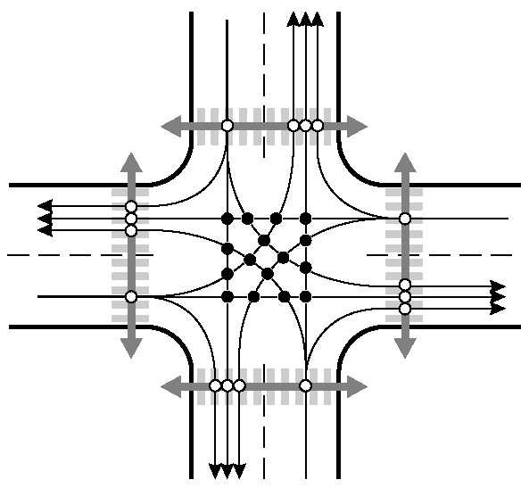
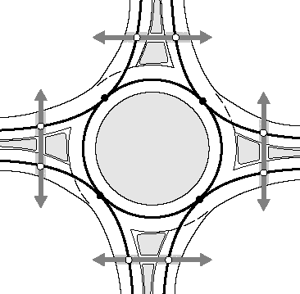
Talking About (Road) Traffic…
Roundabout Advantages [Various Dep. Of Transportation]
  Save Money.
  Reduce Delay and Improve Traffic Flow.
  [ISCA 2007] Rotary Router: An Efficient Architecture for CMP Interconnection Networks
Notes:
16 car-to car posible colisions.
Pedestrian

Slide 4
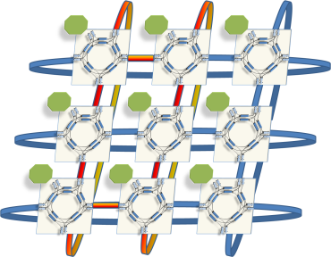
Rotary Router
A packet cannot be blocked by another packet
  Topology agnostic
  No HoLB
Avoid complete exhaustion of network resources
  Injection restriction
N
Injector
Free?
Consumer
No!
W
E
S
Notes:
Don’t exhaust all network buffering and allow free movement of Injection restriction combined with misrouting
Deadlock avoidance
Topology agnostic
Adativerouting
No HLB

Slide 5
Memory Hierarchy Awareness?
Should the interconnection network assist CMP cache coherence protocols?
  Correctness and Performance
Point-to-point ordering
  Token coherence, INSO, … maintenance tasks
Protocol deadlocks induced by consumer overflow and message dependency chain
Injector
N
Injector
N
Consumer
Consumer
Consumer
Injector
Buffer
Buffer
X
X
W
Buffer
E
W
E
Rtg. &
Arb.
S
S
  [NOCS 2008] Reducing the Interconnection Network Cost of Chip Multiprocessors
Notes:
REQUEST BLOCK REPLY PROGRESS

Slide 6
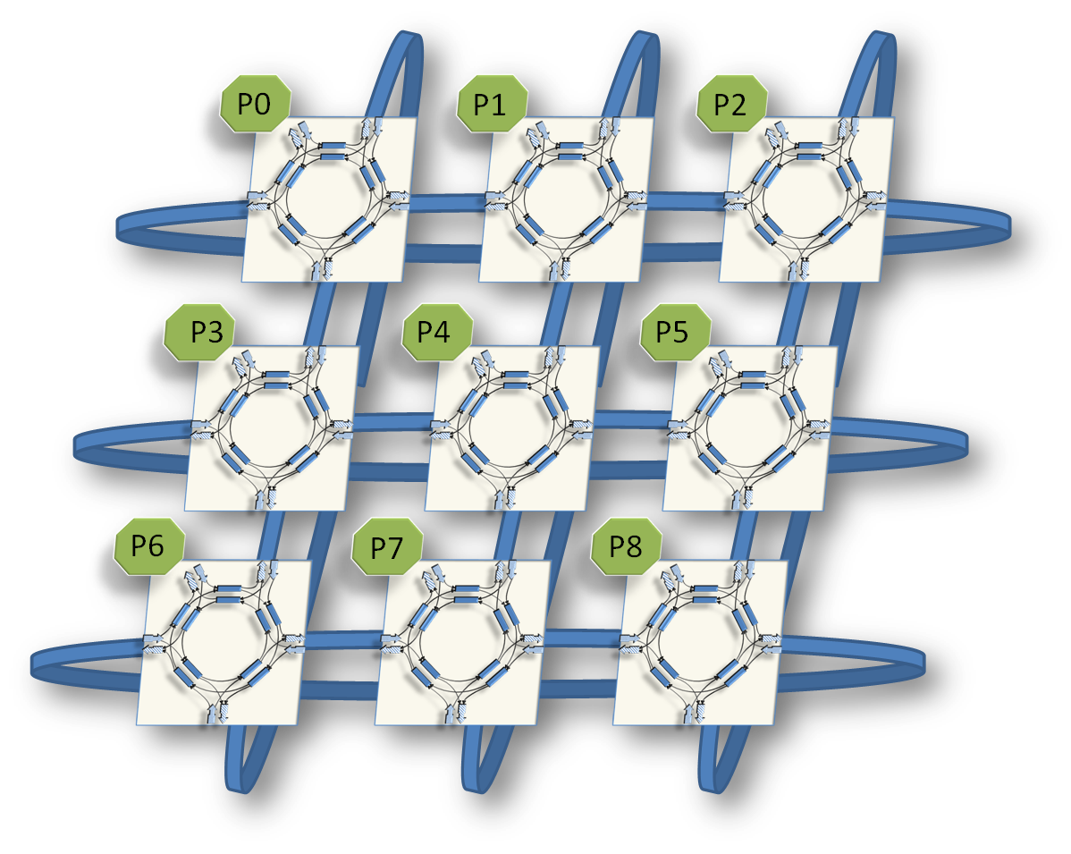
MRR: Multicast Rotary Router
0
1
2
3
…
8
N
0
0
0
0
…
1
E
0
1
1
0
…
0
S
0
0
0
1
…
0
W
0
0
0
0
…
1

Slide 7
MRR: Multicast Rotary Router
0 | 0 | 0 | 0 | 0 | 0 | 1 | 1 | 1
0 | 0 | 0 | 1 | 0 | 1 | 0 | 0 | 1
0 | 0 | 0 | 1 | 0 | 1 | 0 | 0 | 0
0 | 0 | 0 | 1 | 0 | 1 | 0 | 0 | 1
0 | 0 | 0 | 0 | 0 | 0 | 0 | 0 | 1
0 | 0 | 0 | 0 | 0 | 0 | 1 | 1 | 1
0 | 0 | 0 | 1 | 0 | 1 | 0 | 0 | 0
0 | 0 | 0 | 0 | 0 | 0 | 0 | 0 | 0
0 | 0 | 0 | 1 | 1 | 1 | 0 | 0 | 0
0 | 0 | 0 | 0 | 0 | 0 | 0 | 0 | 0
0 | 0 | 0 | 1 | 0 | 1 | 0 | 0 | 0
0 | 0 | 0 | 1 | 0 | 1 | 0 | 0 | 0
Notes:
1-HEADER
2-DIRECTION

Slide 8


Network correctness

Slide 9
Adaptive Multicast Tree
P0
P1
P2
P3
P6
P4
P5
P7
P8

Slide 10
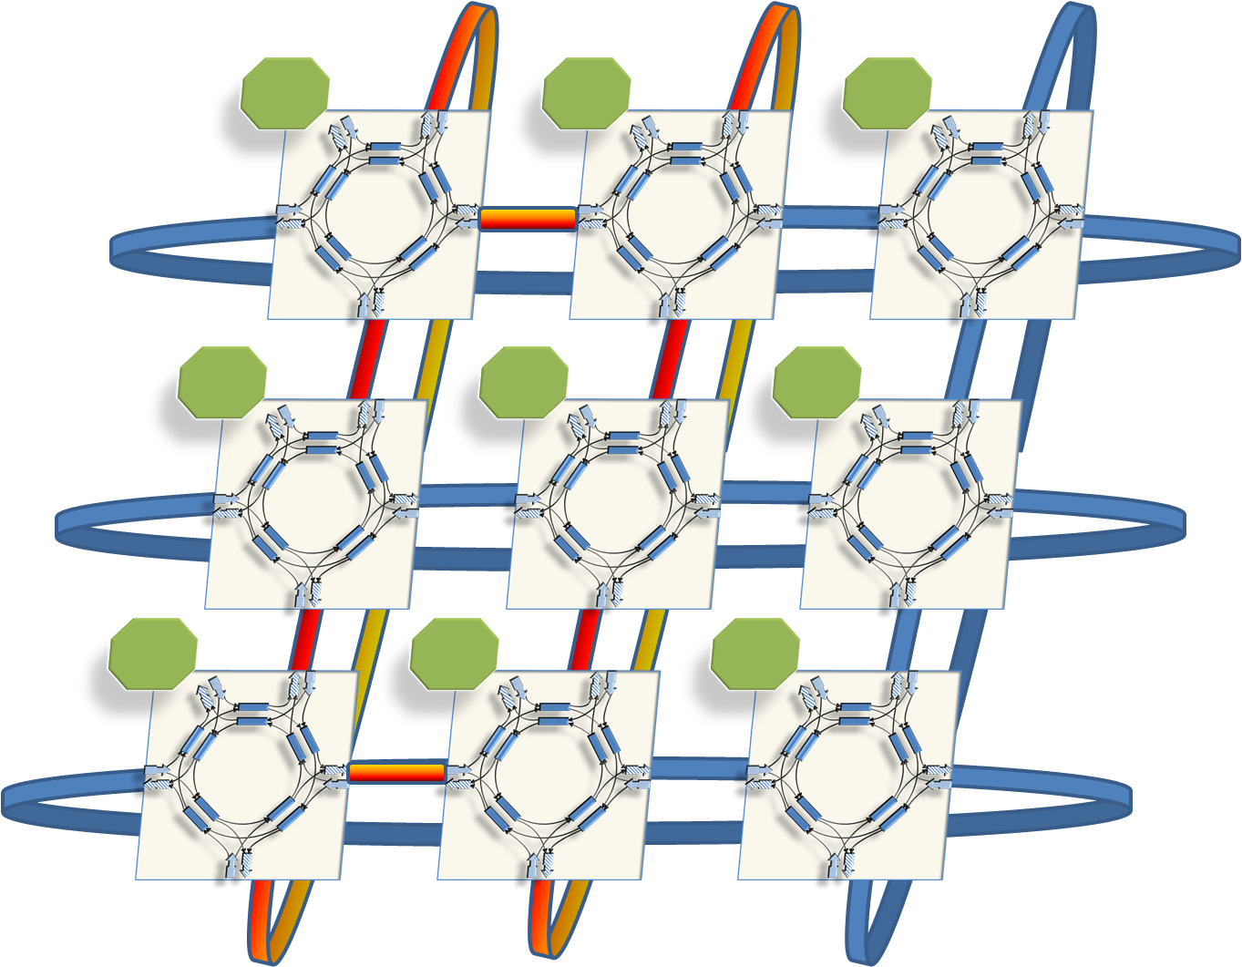
Adaptive Multicast Tree
P0
P0
P1
P2
P6
P2
P3
P4
P5
P7
P5
P8
P6
P7
P8
P4
P1
P3
Notes:
floja

Slide 11
Evaluation Framework
System
Cores | 16 Cores, @4GHz, OOO, 4-wide issue, 64-entry IW, 16 outstanding Mem. Req
L2 | 16 MB, SNUCA, Token(B) coherence protocol, 6 msg. dependence chain
Memory | 4GB, 320GB/s, 260 cycles
OS | Solaris 9
Network
Topology | 8x8 Torus
Links | 1cycle, 128bits wide
Counterparts | (RR)Rotary Router
 | (BASE) Dimension Order Routing
 | (BASE-MC) DOR with ideal VCTM
Buffering | 300 phits (<5KB) per router
Simics
GEMS
Ruby
Opal
Orion
SICOSYS
Notes:
DOR TREE
4 CYCLES PER ROUTER

Slide 12
Full System Performance
Wisconsin Commercial
Workload Suite
NAS Parallel
Benchmarks
(OpenMP)
SPEC 2000
rate

Slide 13
Closer look at “Integer Sort” (IS)
Notes:
Empezar por el peor

Slide 14
Summary and Open Issues
Network should be conceived in a holistic way with the rest of the system
  Network support for multicast could have a noticeable benefit on full CMP performance and energy
MRR adds adaptive multicast
  Feasible alterative for CMP
  Good performance stability
Underestimate contention could be “dangerous”
  Buffering?
  Oblivious routing?
  …
TODO: Router bypass in low load conditions

Slide 15
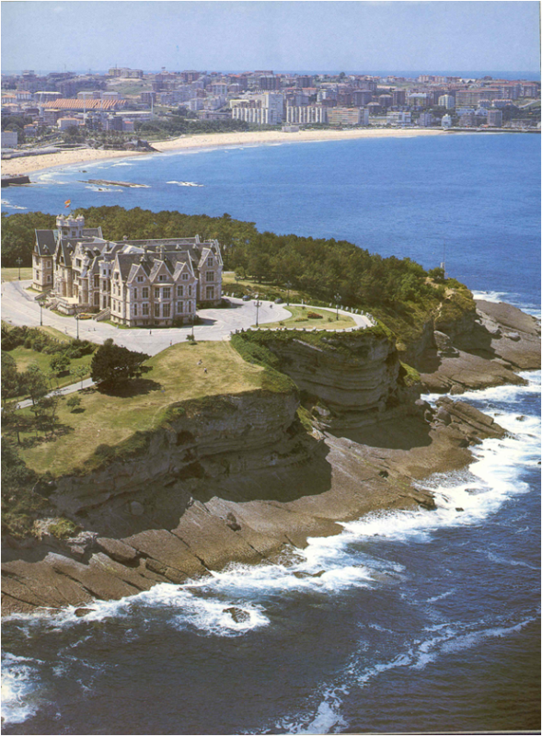
Muchas gracias, Preguntas?

Slide 16
Backup Slides

Slide 17
Network Energy-Performance Tradeoff

Slide 18
Adaptative Multicast
Notes:
4x4, 10% broadcast
DECOMPOSE 1 MESSAGE in 16 PACKETs

Slide 19
Synthetic Traffic: Throughput at Max Load
15% Bcast
10% Bcast
5% Bcast
Notes:
ROTARY IMPROVES BASE
MULTICAST SUPPORT IMPROVES NON SUPPORT
TORANDO

Slide 20
Closer look at “Tornado”

Slide 21
Synthetic Traffic: Base latency
15% Bcast
10% Bcast
5% Bcast
Notes:
SERIALIZATION AT INJETION QUEUE
SERIALIZATION AT THE BRANCHES OF THE TREE

Slide 22
System Energy-Performance Tradeoff

Slide 23
Adaptive Multicast Tree
Notes:
WORST AVERAGE DISTANCE not imply WORST LATENCY. We are NICE with the network.

Slide 24
Adaptive Multicast Tree

Slide 25
Synthetic Traffic (Uniform 8-MC)
Notes:
(8mcast-8x8Torus)

Slide 26
Closer look at Integer Sort (IS)

Slide 27
Synthetic Traffic (8-MC)
Notes:
Latencia

Slide 28
BASE-MC vs BASE: Comm. Phase

Slide 29
Network Energy

Slide 30
Header Overhead
Plain MRR Destination Encoding vs. VCTM Destination Encoding
  16 Node Network => 16 bits vs. 17 bits (3 UC/MC, 10 VCTree, 4 Unicast dest.)
  64 Node Network => 64 bits vs . 23 bits (3 UC/MC, 12 VCTree, 8 Unicast dest.)
Protocol Payload (Token Coherence 8x8)
  40 bits address (24 shadow bits)
  24 shadow bits we can encode: Src , Transaction, class, tokens, etc…
64bits is enough for protocol payload => MRR has not impact
  In 1 flit with 128 bits wide links we can accommodate the whole header
We are currently working on sequential injection (down to N/4) bits)

