Slide 1

TOPAZ: An Open-Source Interconnection Network Simulator for Chip Multiprocessors and Supercomputers
Pablo Abad, Pablo Prieto, Lucia Menezo, Adrian Colaso, Valentin Puente, Jose-Angel Gregorio
University of Cantabria

Slide 2

Interconnects Research: Simulation Tool
What makes a Simulation Tool better than others?
TOPAZ
Flexibility
Heterogeneous field, from supercomputers to CMP.
Highly Configurable
Interfaz to Full-System Simulation.
Multithreaded simulation for massive number of routers.
Accuracy Vs. Comp. Effort
Simple & Complex models.
Dynamic accuracy simulation.
- Avoid slow simulations for first stages of research process.
But provide accurate enough results at last stages.
Many out-of-the-box components.
Very modular code, easy to understand.
Ease-of-Use
Fast learning is essential.
MAX: 1-day delay for user-mode

Slide 3
Outline
Simulator Description
Out-of-the-Box
Utilization Examples
Support & Collaboration
Notes:
<Literal>

Slide 4
Main Features
Evolution of SICOSYS
Object-oriented Design
Different levels of detail
Support for parallel execution
Implemented in C++
100 classes / 50,000 lines of code
High portability (C++ standard compiler)
[REF] V.Puente, J.A. Gregorio, R. Beivide, SICOSYS: an integrated framework for studying interconnection network performance in multiprocessor systems. IEEE Comput. Soc, 2000.
Notes:
<Literal>

Slide 5
Main Features
Evolution of SICOSYS
Object-oriented Design
Different levels of detail
Support for parallel execution
SIMPLE ROUTER
1-C++ class description
(+) Fast Simulation
(--) Accuracy
DETAILED ROUTER
C++ class per component
(--) Slower Simulation
(++) Higher Accuracy
T1
T2
T3
N
Consumer
Injector
W
Crossbar
Buffer
Rtg. &
Arb.
S
Notes:
<Literal>

Slide 6
Using TOPAZ (Building)
>./TPZSimul –s SIMUL_DETAILED
TPZSimul.ini
Router.sgm
<RouterFile id="../sgm/Router.sgm" >
<NetworkFile id="../sgm/Network.sgm" >
<SimulationFile id="../sgm/Simula.sgm" >
<Router id="DETAILED" inputs=5 outputs=5 bufferSize=64 bufferControl=CT routingControl="ROUTING_ALG">
<Injector id="INJ">
<Consumerid="CONS">
<Buffer id="BUF1" type="X+" headerDelay=2>
<Buffer id="BUF2" type="X-" headerDelay=2>
. . . . . . . . . . .
<Buffer id="BUF5" type="Node" headerDelay=2>
<Routing id="RTG1" type="X+" headerDelay=1>
. . . . . . . . . . .
<Routing id="RTG5" type="Node" headerDelay=1>
<Crossbar id="XBAR" inputs="5" outputs="5" type="CT">
<Input id=1 type="X+">
. . . . . . . . . . .
<Output id=5 type="Node">
</Crossbar>
<Connection id="C01" source="INJ" destination="BUF5">
. . . . . . . . . . .
<Connection id="C20" source="RTG.1" destination="XBAR.1">
. . . . . . . . . . .
</Router>
Simula.sgm
<Simulation id="SIMUL_DETAILED">
<Network id="TORUS">
<SimulationCycles id=1000000>
<DiscardTraffic id=10000>
<TrafficPattern id="MODAL" type=”RANDOM”>
<Load id=0.5>
<PacketLength id=2>
</Simulation>
Network.sgm
<TorusNetwork id="TORUS" sizeX=8 sizeY=8 router="DETAILED" delay=1>
<MeshNetwork id="MESH" sizeX=8 sizeY=8 router="DETAILED" delay=1>

Slide 7
Using TOPAZ (Printing)
Standalone
Throughput/Latency curves
Latency Histogram
Injection/Consumption/Link map
+ Gems (or Gem5)
+ Orion
Throughput/Latency evolution
Power Breakdown

Slide 8
Outline
Simulator Description
Out-of-the-Box
Utilization Examples
Support & Collaboration
Notes:
<Literal>

Slide 9
Out of the Box
1. Configuration Parameters
Router
Flow Control
Topology
Traffic
Buffer Size
Random
Virtual Cut Through
Ring
Buffer Delay
Bit-Reversal
Packet Size
Mesh (2D & 3D)
Perfect-Shuffle
Bubble Flow Control
# Virtual Channels
Transpose Matrix
Torus (2D & 3D)
#Physical networks
Tornado
Wormhole
Message Types
Midimew (2D)
Hot-Spot
Router Pipeline
Local
Virtual Channel flow Control
Square Midimew (2D)
Link Delay
Trace-Based

Slide 10
Out of the Box
2. Available Routers
Router
REF
Year
Level of Detail
Adaptive Bubble Router
[14]
2001
Complex & simple
Deterministic Bubble Router
[15]
1998
Complex & simple
Deterministic with VC (Dally)
[16][17]
2001
Complex & simple
VCTM (Dally + MC Support)
[18]
2008
Complex & simple
Pipeline Optimized
[24]
2008
Complex & simple
Rotary Router
[19]
2007
Complex
Bufferless Router
[21]
2010
Simple
Bidirectional Router
[22]
2009
Simple
Buffered Crossbar
[23]
1987
Complex

Slide 11
Out of the Box
3. Integration with Full-System Simulation Tools
Opal (processor)
Simics
Topaz( Network)
Ruby (Memory)
M5 (processor)
Wisconsin Multifacet Gems: http://research.cs.wisc.edu/gems/
Gem5 simulator system: http://gem5.org/Main_Page

Slide 12
Outline
Simulator Description
Out-of-the-Box
Utilization Examples
Support & Collaboration
Notes:
<Literal>

Slide 13
Increasing Full-System simulation accuracy
Main System Parameters
System |  |  |  | Network
Cores | 16 Cores, @4GHz, OOO, 4-wide issue, 64-entry IW, 16 outstanding Mem. Req | L2 | 16 MB, SNUCA, Token(B) coherence protocol, 6 msg. dependence chain | Topology | 4x4 Mesh
L1 | Independent I/D caches, 32KB, 4-way, 1 cycles | L2 Bank | 1MB, 16-way, 5 cycles, pseudo LRU | Links | 1 cycle, 128bits wide
Memory | 4GB, 320GB/s, 260 cycles | OS | Solaris 10
Broadcast Coherence Protocol (Execution Time)

Slide 14
Increasing Full-System simulation accuracy
Simulation speed (cycles/second)
More Accuracy => Slower simulations
On average, Ruby is ≈ 2X faster
Execution Time

Slide 15
Improving Simulation Speed (I)
Simulation speed (cycles/second)
Adaptive Interface
Execution Time
RUBY
TOPAZ
RUBY

Slide 16
Improving Simulation Speed (II)
Simulation speed (cycles/second)
2-Thread Simulation
T1
T2
Execution Time

Slide 17
Simulating thousand-node Networks
12-Core ( Xeon E5645) server with 54GBytes of main memory.
49GB
24GB
5.5GB
12GB
1.5GB
3D Torus, Bubble Router (simple), similar to IBM Blue Gene.
Multithreaded implementation takes advantage of multicore server
Good speedup for 1 Million routers

Slide 18
Outline
Simulator Description
Out-of-the-Box
Utilization Examples
Support & Collaboration
Notes:
<Literal>

Slide 19
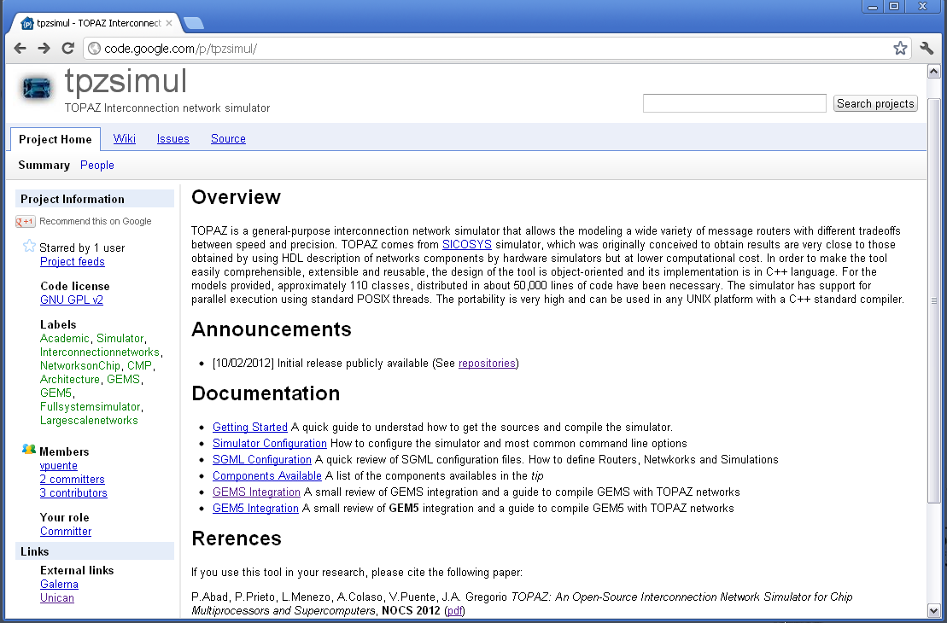
Support & Collaboration
code.google.com/p/tpzsimul

Slide 20
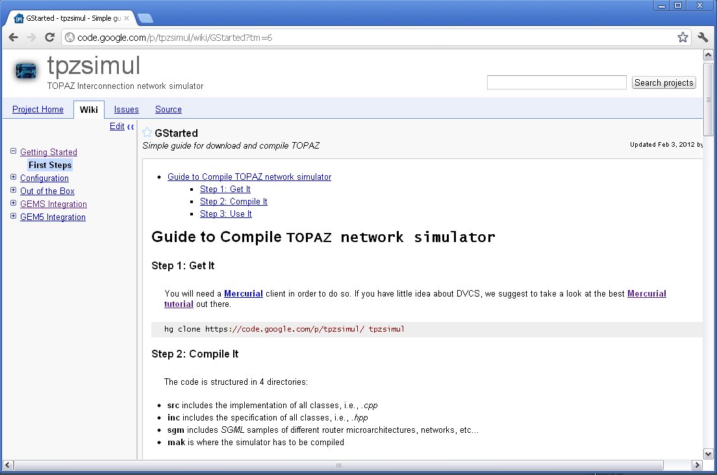
Support & Collaboration

Slide 21
Thanks for your attention
Questions?
http://www.atc.unican.es/galerna/index.html

Slide 22
T1
T2
T3
T4

Slide 23

Using TOPAZ
BUILDING
RUNNING
PRINTING

Slide 24
Using TOPAZ (Building)
Router.sgm
Router & Crossbar Ports
Buffer Size
Routing & Flow Control Policies
Network.sgm
Crossbar

Slide 25
Using TOPAZ (Building)
Router.sgm
Router & Crossbar Ports
Buffer Size
Routing & Flow Control Policies
Network.sgm
Network Size
Network Topology
Link Delay
Simula.sgm
Traffic Pattern
Message Size
Simulation Cycles

Slide 26
Using TOPAZ (Running)
No need to re-compile
Only need to add new configutations at sgml files.
Each configuration identified by a tag at Simula.sgm. Option –s at command line to choose a specific configuration.
Different Execution Modes:
Run your simulation for XXX Cycles.
Run your simulation until YYY Messages reach their destination.
Command Line Options:
Many sgml parameters can be overwritten through command line options.
Example:
Useful for scripting.

