Slide 1
LIGERO: A Light but Efficient Router Conceived for Cache Coherent Chip Multi Processors
Pablo Abad, Valentin Puente, Jose-Angel Gregorio
University of Cantabria
Spain

Slide 2
Networks on Chip FOR cache Coherent CMPs
Coherence protocols are tricky
  Hard to design
  Hard to verify
Interconnection network and coherence protocols design are not orthogonal
  Complexity
  Performance
To satisfy scalability and cost goals, complex non-totally ordered and rich topologies are required
  How to design such networks without difficult the work to the coherence protocol designer?
Notes:
Totally ordered networks (bus) or restricted topologies (rings) simplify design

Slide 3
Correctness
Interconnection Network Level Correctness
  Anomaly free network (deadlock, starvation, live lock…)
Coherence Protocol Level Correctness
  End-to-end (a.k.a. Message-dependent) deadlock
  In-Order Delivery

Slide 4
Example: End-to-End Deadlock
Coherence-controller
REP-OUT
REP-IN
REQ-OUT
REQ-IN
REP-OUT
REP-IN
REQ-OUT
REQ-IN
Router A
Router B
1 Router A and Router B flood the network with REQUEST messages
2 REQUEST messages are only attended if a REPLY can be generated
The hole leaved by an attended REQUEST is occupied by another REQUEST
3 DEADLOCK: No more REQUESTS can be attended and REPLIES cannot reach destination.

Slide 5
Options for Network Designer
Clearing the ball…
  …and rely in coherence protocol designer
    Traffic drop, software assisted solutions…
    Add more complexity to a very complex task?
  …and rely in non-orthogonal solutions
    Physically or virtually separated networks (for each traffic)
    Usually have non-obvious impact on proposal
Face the problem …
  Propose a comprehensive solution to guarantee network and coherence protocol correctness

Slide 6
Optimal Network Design Point
Latency versus maximum sustained throughput
  General purpose computation makes hard to find the sweet spot

Slide 7


Helping Features
Some network features can ease protocol design significantly
In-network multicast support
  Can reduce or eliminate directory overheads
Core0
Core1
Core2
Core3
LLC
Bank
R
LLC
Bank
LLC
Bank
R
R
LLC
Bank
R
LLC
Bank
R
LLC
Bank
LLC
Bank
R
R
LLC
Bank
R
R
R
LLC
Bank
R
R
LLC
Bank
LLC
Bank
LLC
Bank
R
R
LLC
Bank
R
R
LLC
Bank
LLC
Bank
LLC
Bank
Core4
Core5
Core6
Core7

Slide 8
Helping Features
Some network features can ease protocol design significantly
In-network multicast support
  Can reduce or eliminate directory overheads
Adaptive multicast
  Adjust the multicast tree to network conditions
Core0
Core1
Core2
Core3
LLC
Bank
R
LLC
Bank
LLC
Bank
R
R
LLC
Bank
R
LLC
Bank
R
LLC
Bank
LLC
Bank
R
R
LLC
Bank
R
R
R
LLC
Bank
R
R
LLC
Bank
LLC
Bank
LLC
Bank
R
R
LLC
Bank
R
R
LLC
Bank
LLC
Bank
LLC
Bank
Core4
Core5
Core6
Core7

Slide 9
LIGERO
LIGhtweight but Efficient ROuter
  Keep router complexity as low as possible but having as much as possible performance benefits
  Help as much as possible coherence protocol
Goals
  1-cycle pass-through latency under low load
  Adaptive routing
  Low buffering requirements
  End-to-end deadlock avoidance
  Adaptive in-network multicast support
  In order delivery

Slide 10
LIGERO
CONS
INJ
X+
X+
X+ B. Block
EJECTION
Loop
RECEPTION
X+
Y+
Y-
X+
Y+ B. Block
CONS
Y- B. Block
INJ
LOCAL NODE
Loop
Loop
Y+
Y-
X- B. Block
X-
X-

Slide 11
LIGERO
CONS
INJ
X+
X+
X+ B. Block
EJECTION
Loop
RECEPTION
X+
Y+
Y-
X+
Y+ B. Block
CONS
Y- B. Block
INJ
LOCAL NODE
Loop
Loop
Y+
Y-
X- B. Block
Consumption
Injection
X-
X-

Slide 12
LIGERO
X+
X+
X+ B. Block
Loop
12
13
14
15
Y+
Y-
Y+ B. Block
CONS
Y- B. Block
8
9
10
11
INJ
4
5
6
7
LOCAL
NODE
Y+
Y-
0
1
2
3
X- B. Block
X-
X-

Slide 13

Network Correctness
Injection Restriction
  Guarantee that inner loop is not blocked
  Guarantee that at least one packet hole in the network can move (lifesaver hole)
  Doing it with local information
Hamiltonian miss-routing
12
13
14
15
8
9
10
11
CONS
INJ
CONS
INJ
RECEPTION
EJECTION
RECEPTION
EJECTION
4
5
6
7
X+
X+
Loop
Loop
Loop
Loop
0
1
2
3

Slide 14
Network Correctness
Injection Restriction
  Guarantee that inner loop is not blocked
  Guarantee that at least one packet hole in the network can move (lifesaver hole)
  Doing it with local information
Hamiltonian miss-routing
12
13
14
15
8
9
10
11
CONS
INJ
CONS
INJ
RECEPTION
EJECTION
RECEPTION
EJECTION
4
5
6
7
X+
X+
Loop
Loop
Loop
Loop
0
1
2
3

Slide 15
End-to-end Deadlock Avoidance
12
13
14
15
Non Blocking
8
9
10
11
Blocking
4
5
6
7
0
1
2
3

Slide 16
End-to-end Deadlock Avoidance
PROTOCOL:
RESERVATION:
REP
REQUEST
REPLY
REQ & REP
STOP REQUEST
STOP REQUEST
Blocking
NON Blocking
Blocking
NON Blocking
Blocking
NON Blocking

Slide 17
Adaptive In-network Multicast
Path-based multicast
Tree-based multicast
SRC
DST
DST
DST
DST
DST
DST
DST
DST
DST
DST
Poor link utilization (better than UC)
Better link utilization (8 vs 12)
High latency
Better latency (6 hops vc 12 hops)
Simple deadlock avoidance
More deadlock-prone
Fixed network occupancy
Increased network congestion

Slide 18
Adaptive In-network Multicast
Would it be possible to dynamically select the optimal multicast approach?
Notes:
4x4, 10% broadcast
DECOMPOSE 1 MESSAGE in 16 PACKETs

Slide 19
Adaptive In-network Multicast
?

Slide 20
Adaptive In-network Multicast
In the absence of contention, multicast messages follow a tree-based algorithm to reach destination
4
0
1
2
1
5
7
3
3
4
5
0
2
8
6
6
7
8

Slide 21
Adaptive In-network Multicast
What happens if part of network link are congested?
4
0
1
2
Tree-based behavior
Path-based behavior
3
1
3
4
5
6
0
7
8
6
7
8
5
2

Slide 22
Evaluation Framework
Full System Simulation
Configuration
DSENT
RUBY
OPAL
16 out-of-order cores
16 L2 banks, S-NUCA
Folded Torus 4x4, 16 byte links
Coherence Protocols
  Broadcast based
  Directory Based
11 Applications
  4 Commercial Applications
  4 Numerical kernels
  3 Multiprogrammed workloads
Solaris 10
M
SIMICS
S
I
TOPAZ

Slide 23
Counterpart Routers
Conventional router
Low cost router
Rotary Router (MRR)
N
N
Injector
Consumer
Consumer
Injector
Buffer
W
Crossbar
Buffer
W
E
Rtg. &
Arb.
S
S
Consumer
 | VCTM | CHIPPER | MRR | LIGERO
Low-pass | V | V | X | V
Low-cost | X | V | X | V
Adaptive Routing | X | X | V | V
End-to-end | X* | X | V | V
Multicast | V* | X | V | V
Injector
N
W
E
Crossbar
S
Rtg. &
Arb.

Slide 24
Synthetic Traffic Results (4x4 Torus)

Slide 25
Broadcast Based Coherence Protocol

Slide 26
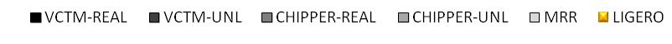
Energy Delay Product

Slide 27
Directory Based Coherence Protocol

Slide 28
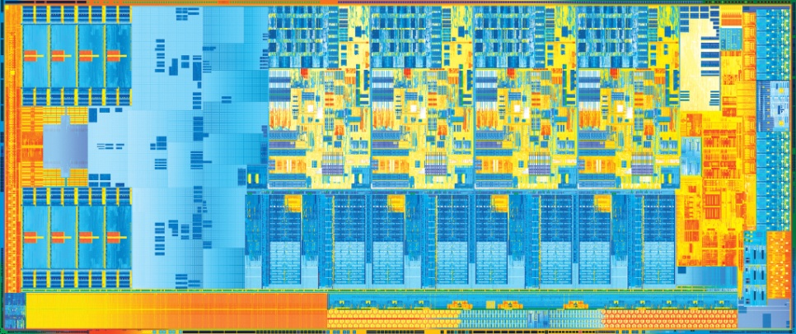
Concluding Remarks
(to our knowledge) There is no high performance & general purpose CMP using anything beyond ring
  Coherence is scary as hell
Scalability issues
  Maybe ok with 8-cores, but will be with 16+ cores and or large LLC?
  Rings has a huge impact on chip yield (with sub 22nm could be critical)
Some of LIGERO ideas could be useful to go beyond?
  … we think so

Slide 29
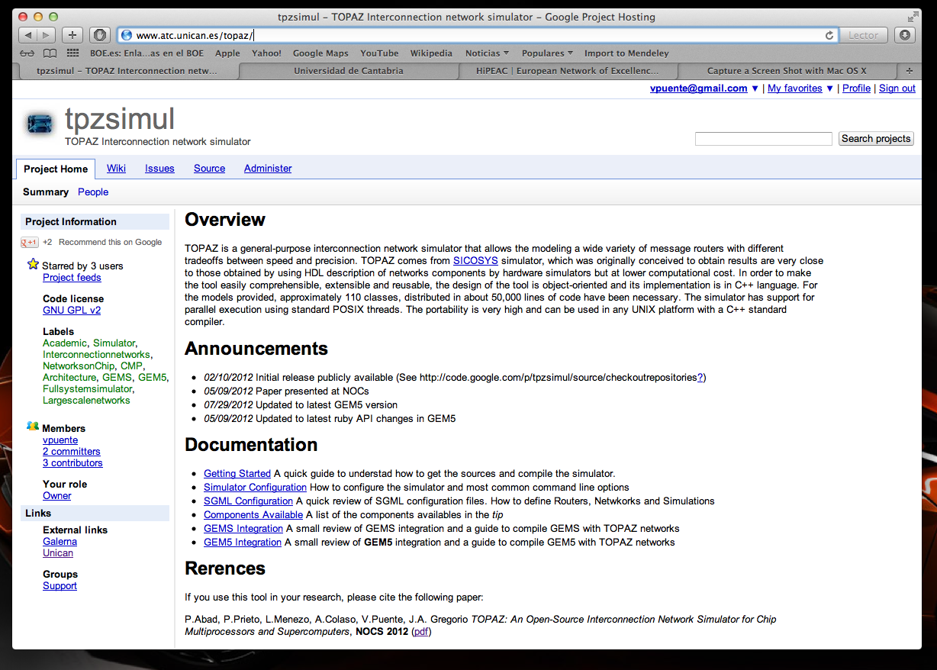
Available to experiment with
go t

