Slide 1

Interaction of NoC design and Coherence Protocol in 3D-stacked CMPs
Pablo Abad, Pablo Prieto, Lucia G. Menezo, Adrian Colaso, Valentin Puente and Jose-Angel Gregorio
University of Cantabria

Slide 2
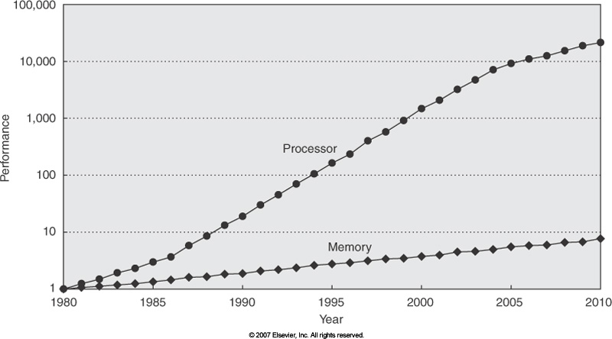
The Memory Wall
  Processor speed improvement largely exceeds DRAM.
  Larger Latencies to access data at main memory.
Core
Core
Core
Core
L1
L1
L1
L1
L2
L2
L2
L2
New Problem: BW Wall
  Core count increases faster than I/O Bandwidth (pin & power)
  Off-Chip BW scarce resource
  Contention increases latency
DRAM
DRAM
DRAM
DRAM
Must Increase On-Chip Storage Capacity

Slide 3
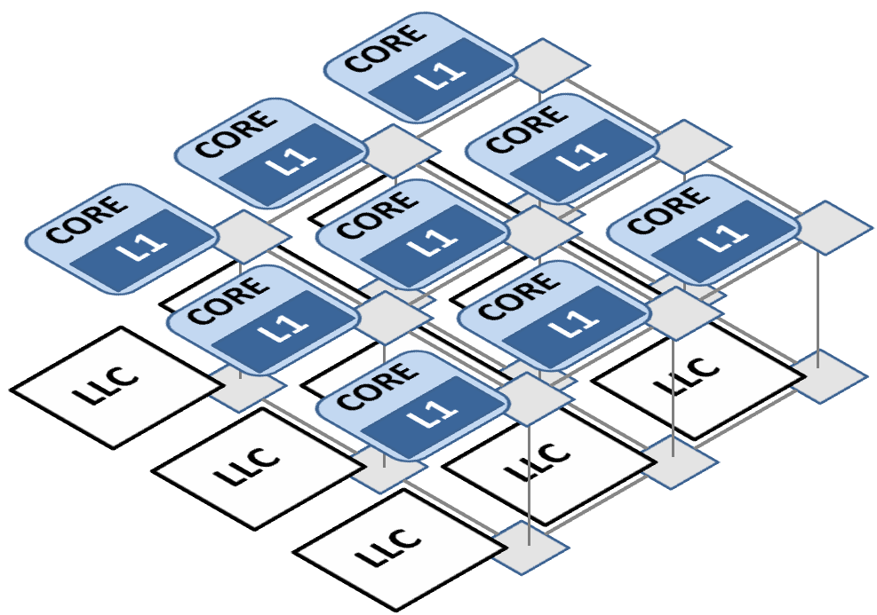
Must Increase On-Chip Storage Capacity
Cores + L1
LLC
3D-Stacking
Non-SRAM technology
Cores + L1
Cores + L1
LLC
Through Silicon Vias
On-Chip Bandwidth Improvement
Minimal latency in Z dimension
Power? Temperature?
PCRAM, STTRAM…
More Density in the same area
Minimal Static Power
Endurance?

Slide 4
Coherence
Protocol
Interconnection
Network
Organization
3D Stacking

Slide 5
Outline
Motivation
Introduction
  Broadcast-Based Coherence
  3d stacking – Coherence – Network interaction
NoC Support
  Class-Aware Routing
  Congestion-Aware Missrouting
  Deadlock Avoidance
  Critical Flit First
Evaluation
Conclusions & Future work
Notes:
<Literal>

Slide 6
Broadcast-Based Coherence (Token)
Broadcast: Efficient cache-to-cache transfers
  Avoid indirections but higher bandwidth requirements
  On-chip environment: high bandwidth availability
  AMD Opteron, IBM Power7, Intel Quickpath
TokenB: a fixed number of tickets (tokens) associated to each block
  One token to read
  All tokens to write
Coherence enforce by counting/exchanging tokens

Slide 7
Broadcast-Based Coherence
Core A
Core 2
Core 3
LOAD
L2
L2
L2
Main Memory Controller
L1
L1
L1
MISS
Core 4
Core 5
Core 6
L2
L2
L2
L1
L1
L1
Core 7
Core 8
Core 9
L2
L2
L2
L1
L1
L1

Slide 8
3D–Coherence–Network Interaction
Core A
Core A
Core A
Core A
Core A
Core A
L2
L2
L2
L2
L2
L2
L1
L1
R₀
L1
R₁
R₂
R₀
R₁
R₂
L1
L1
L1
R₉
R₁₀
R₁₁
R₀
R₁
R₂
Core A
Core A
R₉
Core A
R₁₀
R₉
R₁₁
R₁₀
R₁₁
Core A
Core A
Core A
L2
L2
L2
L2
L2
L2
CORE-L1 LAYER
L1
L1
R₃
L1
R₄
R₅
R₃
R₄
R₅
L1
L1
L1
R₁₃
R₃
R₄
R₅
R₁₂
R₁₄
LLC LAYER
R₁₂
R₁₃
R₁₂
R₁₄
R₁₃
R₁₄
Core A
Core A
Core A
Core A
Core A
Core A
L2
L2
L2
L2
L2
L2
L1
L1
R₆
L1
R₇
R₈
R₆
R₇
R₈
L1
L1
L1
R₁₇
R₆
R₇
R₈
R₁₅
R₁₆
R₁₅
R₁₆
R₁₅
R₁₇
R₁₆
R₁₇

Slide 9
3D–Coherence–Network Interaction
Request-Reply transaction:
  8 link traversals at core-l1 layer …
  Vs 2 link traversals at LLC layer
R₀
R₁
R₂
CORE-L1 LAYER
R₉
R₁₀
R₁₁
R₃
R₄
R₅
R₁₂
R₁₃
R₁₄
R₆
R₇
R₈
LLC LAYER
Unbalanced Network Utilization
R₁₅
R₁₆
R₁₇

Slide 10
3D–Coherence–Network Interaction
Routing restrictions (deadlock) delay some transactions
R₀
R₁
R₂
In the example, XYZ routing artificially delays LLC reqs, routing them through congested resources.
Dimension Ordered Routing also affects L1-to-L1 reqs, due to the congestion levels at Core-L1 layer.
R₉
CORE-L1 LAYER
R₁₀
R₁₁
R₃
R₄
R₅
R₁₂
R₁₃
R₁₄
R₆
R₇
R₈
LLC LAYER
R₁₅
R₁₆
R₁₇

Slide 11
Outline
Motivation
Introduction
  Broadcast-Based Coherence
  3d stacking – Coherence – Network interaction
NoC Support
  Class-Aware Routing
  Congestion-Aware Missrouting
  Deadlock Avoidance
  Critical Flit First
Evaluation
Conclusions & Future work
Notes:
<Literal>

Slide 12
Class-Aware Routing
How do we solve LLC-Request Delay problem?
R₀
R₁
R₂
R₉
CORE-L1 LAYER
If we change routing from XYZ to ZYX we fix this issue …
R₁₀
R₁₁
R₃
R₄
R₅
But we will be degrading Reply latency !!!
R₁₂
R₁₃
R₁₄
LLC LAYER
R₆
R₇
R₈
R₀
R₁
R₂
R₁₅
R₁₆
R₁₇
Must avoid Global routing strategies. Can move to per-Message Class routing.
Requests are routed in ZYX order while Replies keep original order (XYZ).
R₉
R₁₀
R₁₁
R₃
R₄
R₅
R₁₂
R₁₃
R₁₄
R₆
R₇
R₈
R₁₅
R₁₆
R₁₇

Slide 13
Congestion-Aware Missrouting
What about messages with src & dst at Core-L1 layer?
Requests to other L1 caches find lots of contention to access shared resources
They are in the critical path
If we find congested links at intermediate nodes, we could missroute messages to the LLC layer
Messages could reach destination faster due to much lower contention
R₀
R₁
R₂
R₉
CORE-L1 LAYER
R₁₀
R₁₁
R₃
R₄
R₅
R₁₂
R₁₃
R₁₄
Longer distance but Better latency
R₆
R₇
R₈
LLC LAYER
R₁₅
R₁₆
R₁₇

Slide 14

Deadlock Avoidance
Previous methods must keep network Deadlock-Free
  Virtual Channels avoid end-to-end deadlock (only worry about routing deadlock)
  Virtual Channels also help to eliminate cyclic dependencies for both solutions proposed
Class-Aware Routing
  Each message class employs its own buffering resources
  No cycles can be formed between requests (ZYX) and replies (XYZ)
Congestion-Aware Missrouting
  Once a message is missrouted, must follow through LLC layer until destination.
  This way Z+→X or Z+→Y turns are not allowed and deadlock is avoided
R₀
R₁
R₂
R₀
R₁
R₂
R₉
R₁₀
R₁₁
R₉
R₁₀
R₁₁
R₃
R₄
R₅
R₃
R₄
R₅
R₁₂
R₁₃
R₁₄
R₁₂
R₁₃
R₁₄
R₆
R₇
R₈
R₆
R₇
R₈
R₁₅
R₁₆
R₁₇
R₁₅
R₁₆
R₁₇

Slide 15
Critical Flit First
Network support for Critical Word First Technique
  As Mem blocks are larger than words requested by the processor, missed word is given priority, requesting it from memory in first place
  Network messages are usually broken into smaller pieces (flits) with a similar size to processor words
  Block re-ordering can be implemented by network components with very low overhead.
Memory Block
Req word
Req word
Req word
Req word
Conventional
CFF
Body (flit 3)
Header
Body (flit 1)
Tail (flit 4)
Body (flit 1)
Header
Body (flit 2)
Tail (flit 4)
Body (flit 3)
Body (flit 2)

Slide 16
Outline
Motivation
Introduction
  Broadcast-Based Coherence
  3d stacking – Coherence – Network interaction
NoC Support
  Class-Aware Routing
  Congestion-Aware Missrouting
  Deadlock Avoidance
  Critical Flit First
Evaluation
Conclusions & Future work

Slide 17
Evaluation (Simulation Framework)
Sim. Infrastructure
Simulated System
Simics
GEMS
Workloads
Opal
Ruby
Benchmark | Description
Wisconsin Commercial Workload Suite
Apache | Task-parallel web server
Jbb | Java middleware application
Zeus | Pipelined web server
Oltp | Pseudo TCP-C on-line trans. processing
NAS Parallel benchmark
FT | 3-D partial diff. eq. solution using FFTs
IS | Integer sort
SP | Scalar Pentadiagonal solver
MG | Multi-grid on a sequence of meshes
LU | LU solver
TOPAZ
Processor Config. | Number of Cores | 16@4GHz
 | IWin Size/Issue | 128/4-way
L1 Cache | Size/Assoc/Blk/ Time | 32KB, 2-way, 64B, 2-cyc
 | Outst. Mem. Operations | 16
L2 Cache | Size/Assoc/Blk Size/Time | 16MB/16-way/ 64B/5-cyc
 | NUCA Mapping | Static, interlieved across slices
Memory | Capacity/Access Time/Controllers/BW | 4GB/250 cyc/4 centered/ 320GB/s
Network | Topology/Link Lat/Link Width | 4x4x2 Mesh/1 cyc/128 bits (or 64)
 | Router Lat/Buff Size/Rtg | 3 cyc/10 flits per VC/DOR
Simics: full system simulation
GEMS: timing infrastructure, substitutes simics models of some components
Opal: Processor detailed simulation
Ruby: Memory hierarchy implementation
Topaz: Replaces Ruby network models, near-RTL detail level.

Slide 18
Evaluation (Improved Routing)
Class Aware Routing
L1-Core Layer
Z
X
Y
Z
X
Y
LLC Layer
Congestion Aware Missrouting
L1-Core Layer
X
Z
Z
Y
X
LLC Layer

Slide 19
Evaluation (Critical Flit First)
TAIL
Base Latency
Spooling
DATA
DATA
DATA
DATA
DATA
DATA
DATA
DATA
HEAD
TAIL
Base Latency
Spooling
DATA
DATA
DATA
HEAD
5
10
15
20
25

Slide 20
Evaluation (All Together)

Slide 21
Outline
Motivation
Introduction
  Broadcast-Based Coherence
  3d stacking – Coherence – Network interaction
NoC Support
  Class-Aware Routing
  Congestion-Aware Missrouting
  Deadlock Avoidance
  Critical Flit First
Evaluation
Conclusions & Future work
Notes:
<Literal>

Slide 22
Conclusions & Future work
The study of Network, 3D organization and Traffic structure (coherence protocol) can significantly improve CMP performance.
Small but smart router modifications can provide improvements with minimal HW overhead (energy & area).
Adaptive routing policies could help to improve present results even more.
Routing strategies with a target different to performance (Temperature?) could also be interesting.

Slide 23
Thanks for your attention
Notes:
<Literal>

